Slide 1



Assignments Web Part
Using the Education Graph API Endpoints

Slide 2
Tony Phillips
Founder of Cloud Design Box
Worked with SPFx since the preview version
Started working with SharePoint 2003
Not a developer by trade (started with citizen coding in script editor web parts)
I learnt SPFx development from the MS site and from community calls like this
Contact
Twitter: @TonyMSTeams
Blog: www.tonyishere.co.uk
Contact: Tony.Phillips@clouddesignbox.co.uk
Github: https://github.com/CloudDesignBox/CDBAssignments

Slide 3
Endpoints in today’s demo
/education/me
/me/joinedTeams
/education/me/classes
/education/me/assignments
Data populated by Microsoft School Data Sync
Education API reference: https://docs.microsoft.com/en-us/graph/education-concept-overview
Notes:
Today’s demo is only available in education tenants, you can contact Microsoft and get a developer edu tenant
The education me API is just the same as /me but with some extra AAD attributes for the AAD user. In this example we find out if the user is a student or a teacher
/classes is the same as getting your joined teams but filtered by the class team template type with extra attributes like course, etc
/assignments is brand new for education and returns assignments which you can set in class teams.
Really awesome feature, really cutting edge stuff in education.

Slide 4
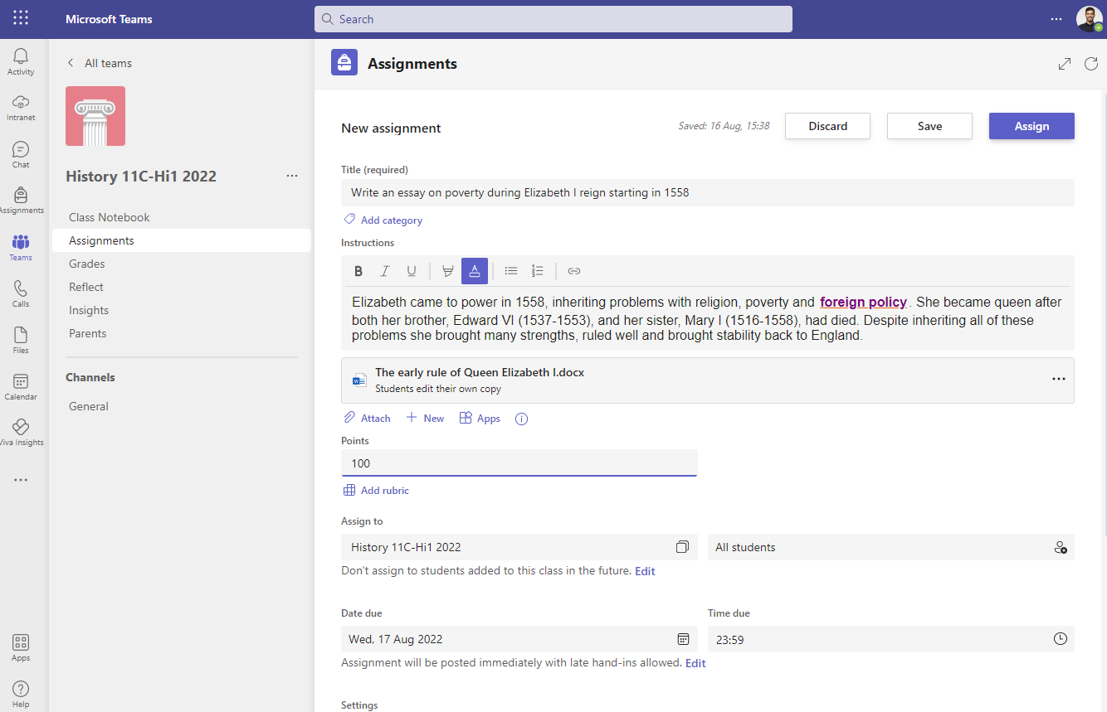
Assignments in Teams

Slide 5
Challenges
No /me assignment endpoint supported until recently
Academic rollover each year / Archived Teams
API throttling
Large amounts of assignments
Notes:
Lack of supported me endpoint meant that it required a lot of calls to get the class teams, then get assignments for each class.
Typical high school has 1200 class teams created every summer – that’s a lot of potential API calls
APIs can get throttled – caching is important
Classes are archived at the end of the academic year
There shouldn’t be a lot of assignments because the teacher or student should submit the assignment and close it off. In reality this doesn’t happen so there might be hundreds of assignments returned for one person.

Slide 6
Demo of SPFx My Assignments Web Part
Notes:
Demo page https://clouddesignboxltd.sharepoint.com/sites/CAA-CloudAcademyPageIdeas
Add web part to the page

Slide 7
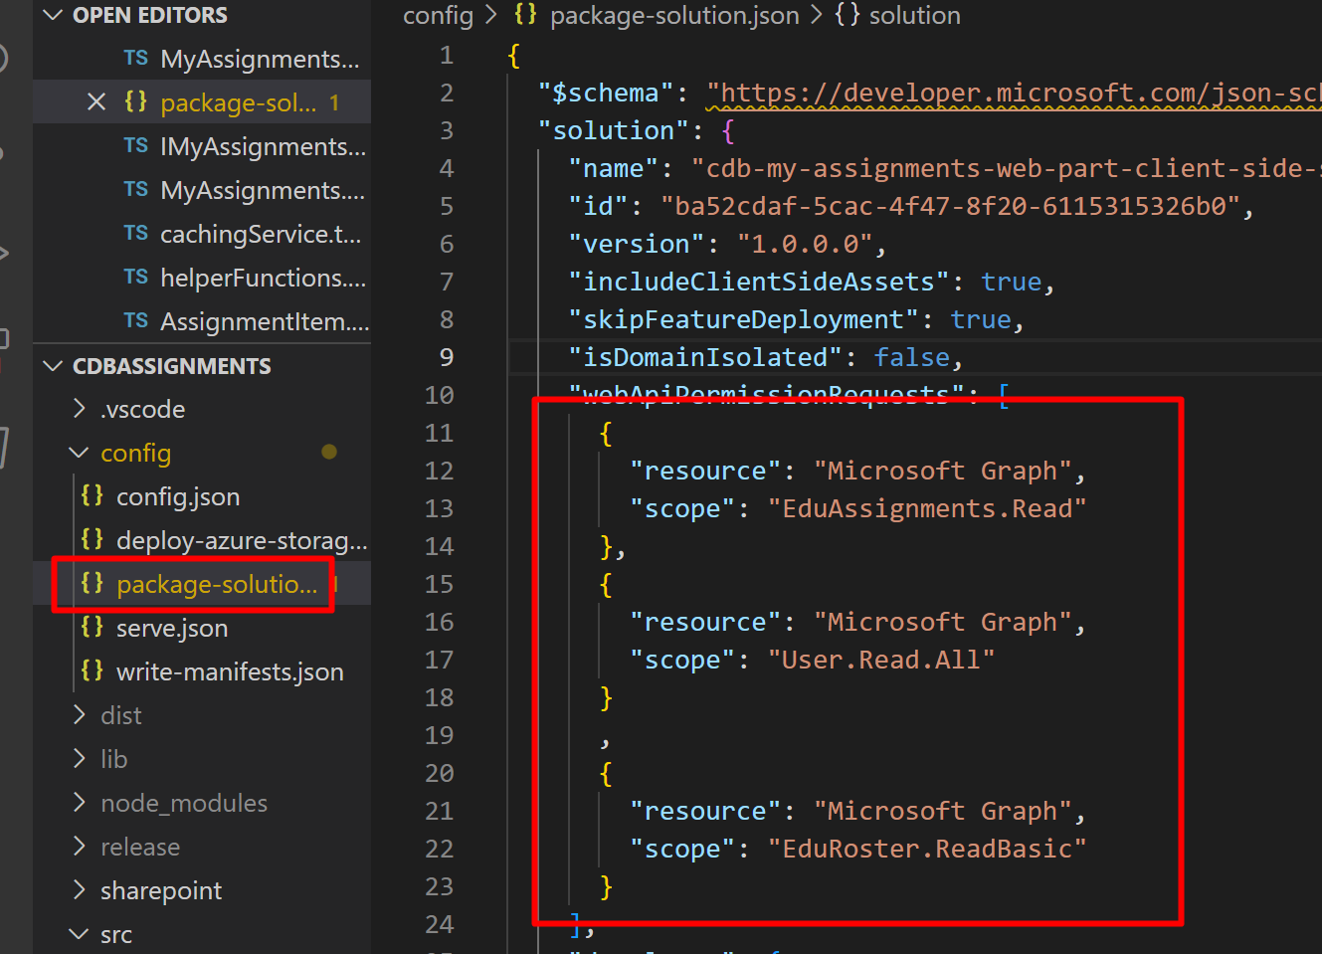
Getting started
React
API permissions
Notes:
Why I picked react
Demo of adding API permissions to web part and how we get that working in dev

Slide 8
Demo

Slide 9
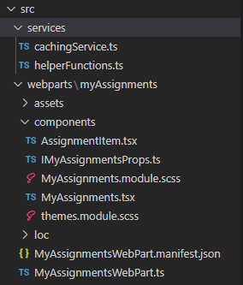
Structure

Slide 10
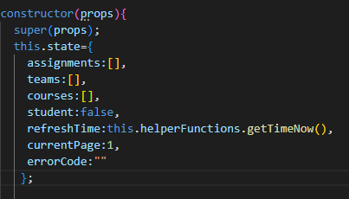
Using state and loading data

Slide 11
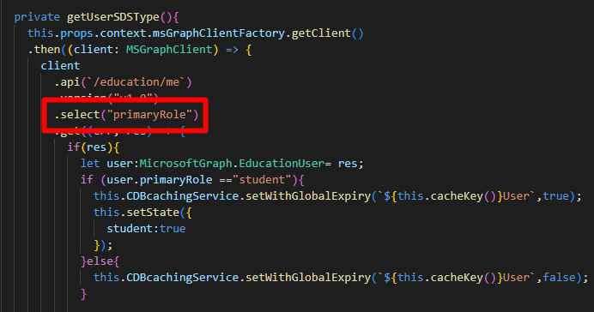
Why teachers and students need different views

Slide 12
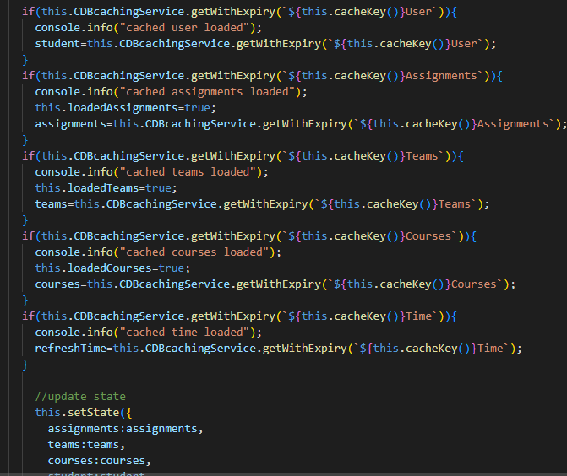
Caching

Slide 13
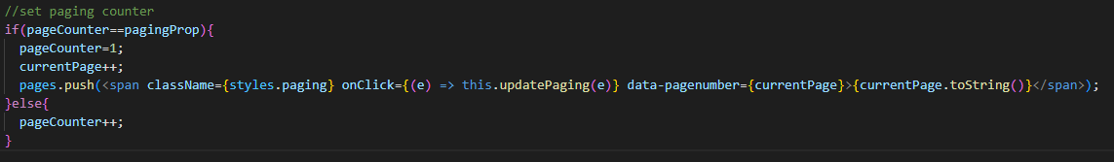
Paging

Slide 14
Tony Phillips
Contact
Twitter: @TonyMSTeams
Blog: www.tonyishere.co.uk
Contact: Tony.Phillips@clouddesignbox.co.uk
Github: https://github.com/CloudDesignBox/CDBAssignments

